Slide 2
TRAFFIC SIGNAL CONTROL OPTIMIZATION UNDER SEVERE INCIDENT CONDITIONS USING GENETIC ALGORITHMS
Tuo Mao
Faculty of Engineering and Information Technology
University of Technology, Sydney
Email: tuo.mao@uts.edu.au
Web: http://fmlab.org/

Slide 3
Overview
Introduction
Methodology
GA optimization process
Experiment design
Results
Conclusion and future works

Slide 4
Introduction
Traffic congestion is classified into two types: recurrent congestion (RC) which can appear due to daily travel patterns and non-recurrent congestion (NRC) which can be caused by unexpected events such as accidents/breakdowns/etc. The most problematic incidents can occur at random locations, at various moments in time and do not ever repeat themselves. It is a big challenge to model and handle the network optimization under these non-recurrent incidents because of its uncertainty of occurrence in both time and space.

Slide 5
Methodology
Problem
Optimizing the signal control plans when severe incidents occur.
Our approach
The approach relies on deploying genetic algorithms (GA) by considering the phase durations as decision variables and the objective function to minimize as the total travel time in the network.

Slide 6
Methodology
Data input
O-D configuration,
O-D demand table,
Network configuration,
Link detail table,
Traffic signal configuration.
Data output
Optimized traffic signal configuration.
Notes:
O-D configuration: contains the location of origins and destinations,
O-D demand table: contains the trips between each pair of origin and destinations,
Network configuration: contains all information about links, nodes, speed limits, road capacity, etc.
Link detail table: contains link free-flow travel time, link speed limit, link capacity, and number of lanes,
Traffic signal configuration: signalized node indexes, number of phases, cycle time, signal timings, phase green splits, and the links granted green for each phase.

Slide 7
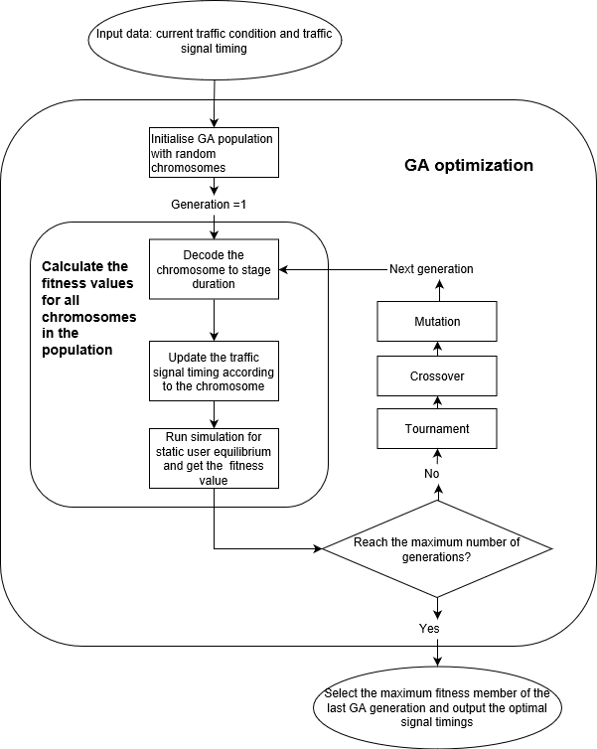
GA optimization process
The target function is to minimize the total travel time of the network.
$$Fitness=− \sum_{a∈A}{\int_{0}^{v_{a}}{t_{a}\left(v_{a},λ_{a}\right)dx}}$$
The decision variable is a vector of all phase durations within the network.
Chromosome (array) = $$\left[ p11,p12,p13,p14, p21,p22,p23,p24, … ,pn1,pn2,pn3,pn4\right]$$

Slide 8
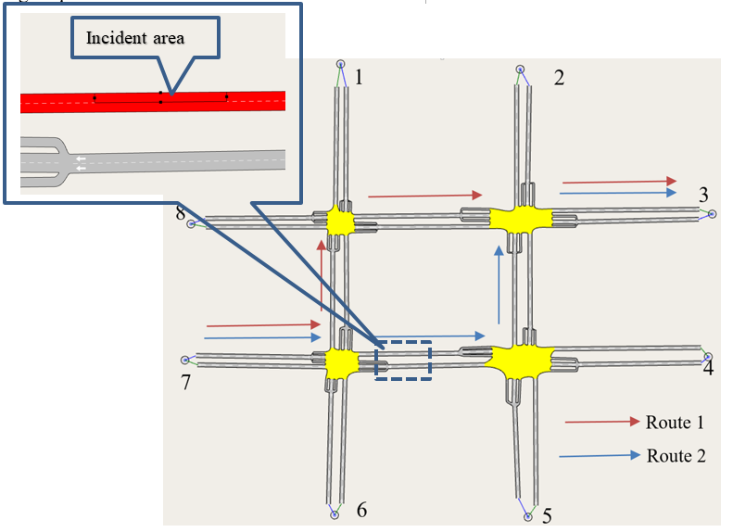
Experiment design
Scenarios
No traffic incident scenario,
Traffic incident scenario without GA traffic control optimization,
Traffic incident scenario with the GA traffic control optimization.
Experiment network

Slide 9
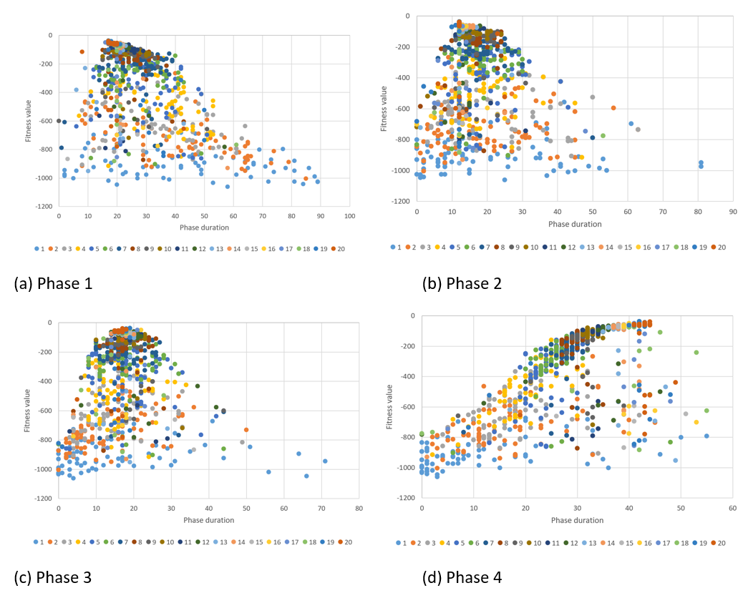
Experiment results
GA optimization
Phase duration convergence in intersection 3

Slide 10
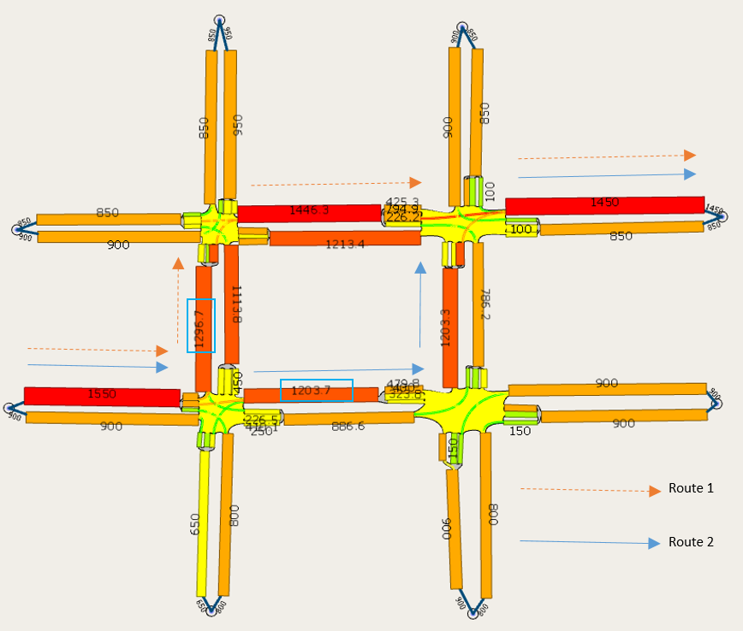
Experiment results
Traffic flow
No traffic incident scenario,
Traffic incident scenario without GA traffic control optimization,
Traffic incident scenario with the GA traffic control optimization.

Slide 11
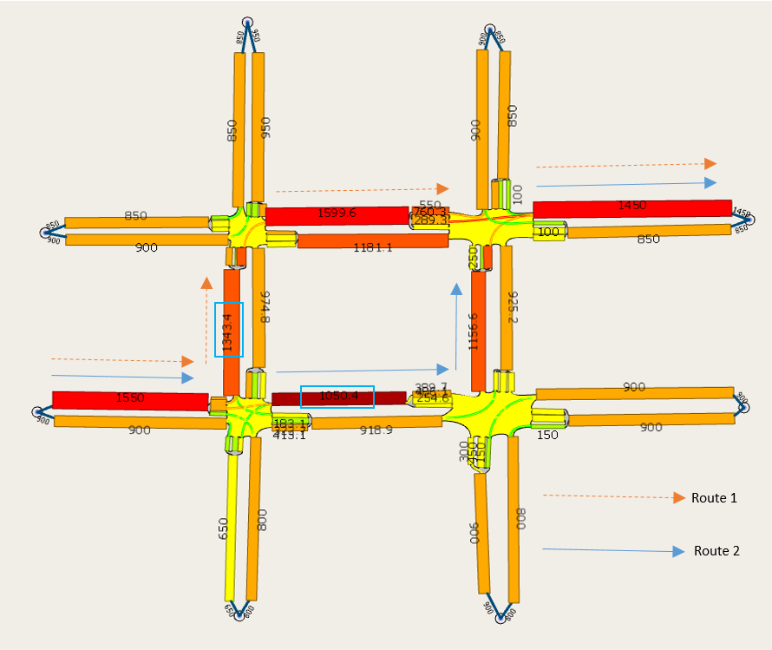
Experiment results
Traffic flow
No traffic incident scenario,
Traffic incident scenario without GA traffic control optimization,
Traffic incident scenario with the GA traffic control optimization.

Slide 12
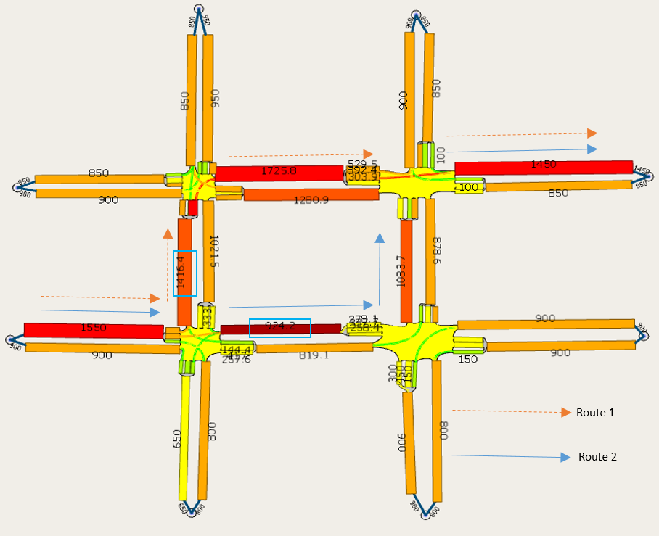
Experiment results
Traffic flow
No traffic incident scenario,
Traffic incident scenario without GA traffic control optimization,
Traffic incident scenario with the GA traffic control optimization.

Slide 13
Experiment results
Simulation statistics
In our case study, a 40.76% of total travel time saving is achieved in our network after applying GA traffic signal optimization under traffic incidents comparing using default pre-optimized traffic signal plan.

Slide 14
Conclusion and future works
The experiment results show improvement of the total travel time if the TMC uses our proposed GA model to re-optimize the traffic control plan if an incident happens in a network.
Future work can be done in investigating more complicated network and even real-world network.
In order to fit the proposed model to real-world application, we are working on enhancing the algorithm to parallel computing and increasing efficiency.
In addition, we are currently deploying machine learning to further scale up the approach for larger networks in Sydney.

Slide 15
Thank you!
http://fmlab.org/

